Slide 1
STAT 717: Lecture 7
Exploratory Factor Analysis
Vitaly Druker
October 14th, 2021

Slide 2
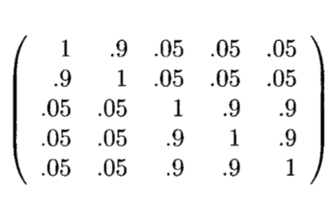

Introduction
Represent variables $y_{1},y_{2}, …, y_{p}$ as linear combinations of unobserved random variables $f_{1},f_{2}, …, f_{m}$ where $m<p$
There may be a subset of variables that are highly correlated amongst themselves but not with others:

Slide 3
Exploratory vs Confirmatory
Exploratory:
Number of latent factors in not determined before
Confirmatory:
Test hypotheses about factors

Slide 4
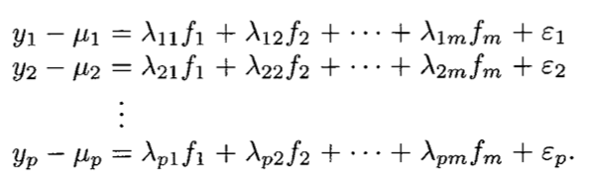
Orthogonal Factor Model
- Lambdas are called loadings
Note there is an error term added (epislon)

Slide 5
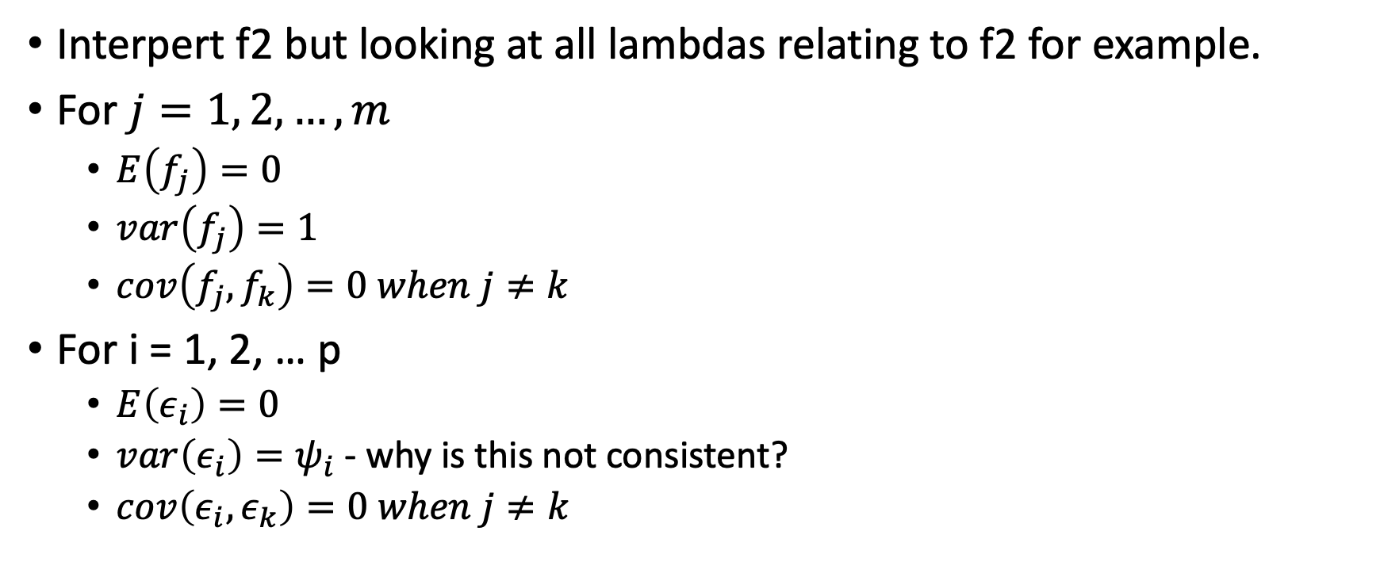
Description
Interpert f2 but looking at all lambdas relating to f2 for example.
For $j=1, 2, …, m$
$E\left(f_{j}\right)=0$
$var\left(f_{j}\right)=1$
$cov\left(f_{j}, f_{k}\right)=0 when j≠k$
For i = 1, 2, … p
$E\left(ε_{i}\right)=0$
$var\left(ε_{i}\right)=ψ_{i}$ - why is this not consistent?
$cov\left(ε_{i},ε_{k}\right)=0 when j≠k$

Slide 6
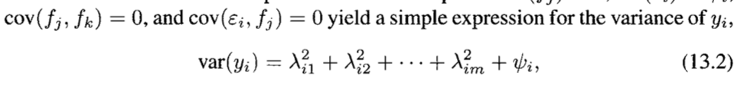
Some ramifications

Slide 7
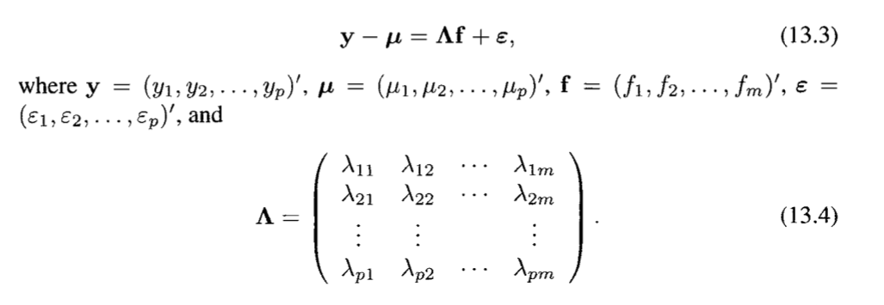
Rewrite the model:

Slide 8
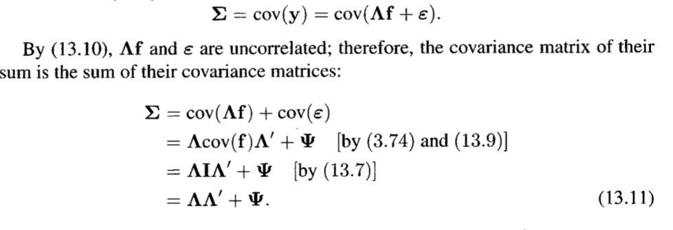
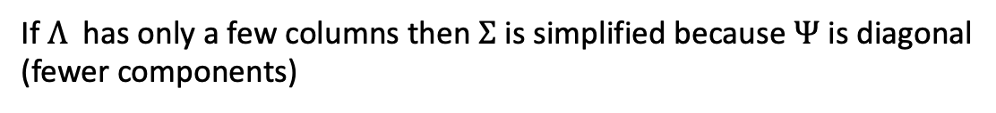
Emphasis on modeling covariance of Y
If $Λ$ has only a few columns then $Σ$ is simplified because $Ψ$ is diagonal
(fewer components)

Slide 9
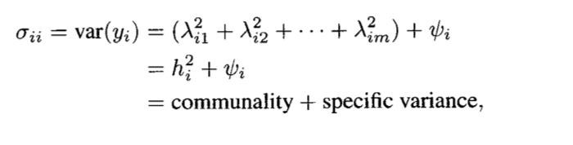
Communality vs Specific Variance

Slide 10
Note:
It’s possible to rotate the loadings (by multiplying by orthogonal matrix) and preserve the properties we have been discussing

Slide 11
Estimation of Loadings and Communalties

Slide 12

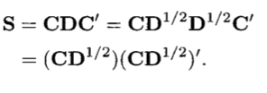
Principal Component Method
Not related to principal component analysis
Ignore Phi
S = CDC’ where C is orthogonal matrix from normalized eigenvectors
D is diagonal matrix with eigen values
Only use a subset eigenvalues so that lambda is p x m
Note that we can (and most often) use R instead of S

Slide 13
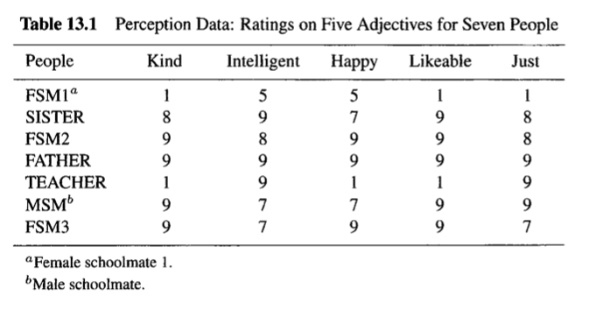
Example 13.3.1

Slide 14
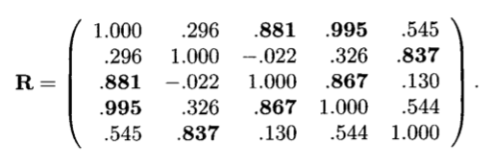
The eigenvalues of R are 3.263, 1.538, .168, .031, and 0.
First two eigenvalues account for 96% of the sample correlation
Therefore just use two factors
Multiply eigenvectors by sqrt of eigen values to get loadings

Slide 15
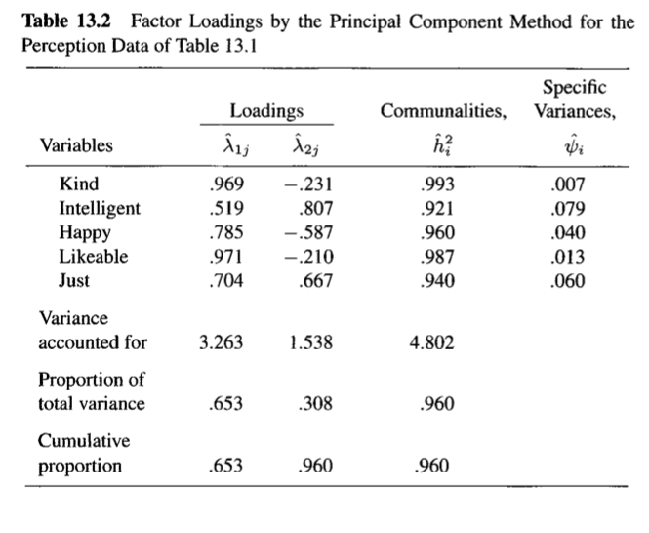

Slide 16
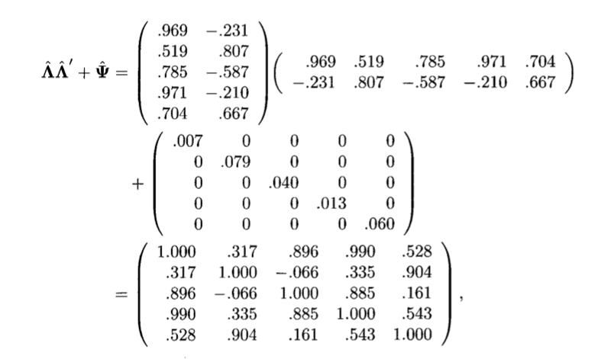
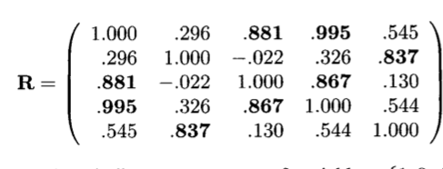
Check how well the factors fit the data

Slide 17

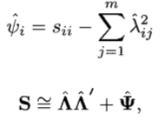
Phi is remaining variance

Slide 18
Choosing the number of Factors

Slide 19
Strategies
Strategies are largely the same as what we discussed for PCA
1. Choose the number of factors so the variance has predetermined percentage
2. Average eigenvalue
3. Scree test
Hypothesis test (won’t discuss here)

Slide 20
Rotation

Slide 21
Introduction
It’s possible to rotate the loadings by multiplying them by an orthogonal matrix
We try to rotate the loadings so that they pass through more of the points of y – this makes it so that factor loadings are more interpretable
Ideally with have each variable associated with one factor (a factor can (and should) be associated with multiple variables

Slide 22

Orthogonal Rotation
Varimax technique seeks to maximize the variance of each column of $Λ.$ If variance is low then loadings are close to each other – we want them being variable so they are better attributed to a particular factor

Slide 23
Simple Structure
each variable is clearly associated with one factor (e.g. only has one high factor loading)

Slide 24
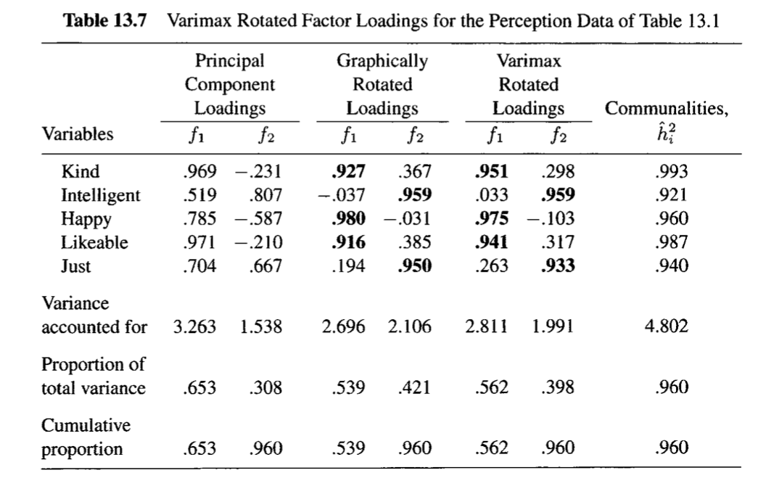
Varimax Rotation

Slide 25
Oblique Rotation
Rotation does not need to be orthogonal – may give a more simple structure to the factors

Slide 26
Interpretation
Find factor that original variable is associated with (bold)
Try to ’label’ the factors based on the factors that are there
What would you label f1 and f2?

Slide 27
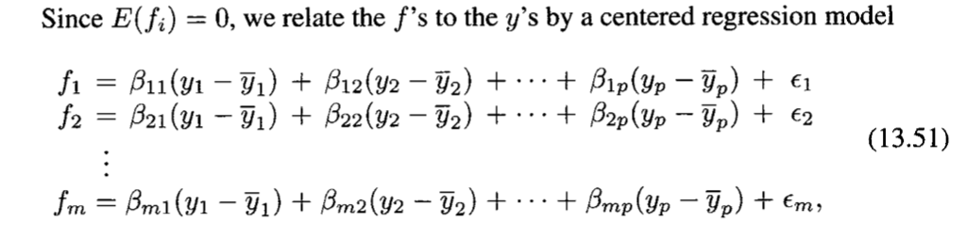
Factor Scores
Sometimes you want to get the underlying factor scores (not just the loadings)
E.g. an emotional score or intelligence score

Slide 28

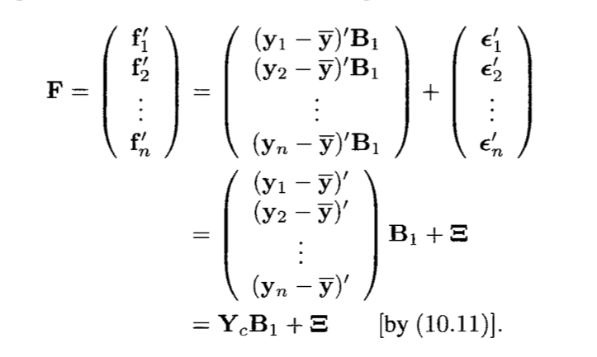

Equations
But F is unobserved….

Slide 29
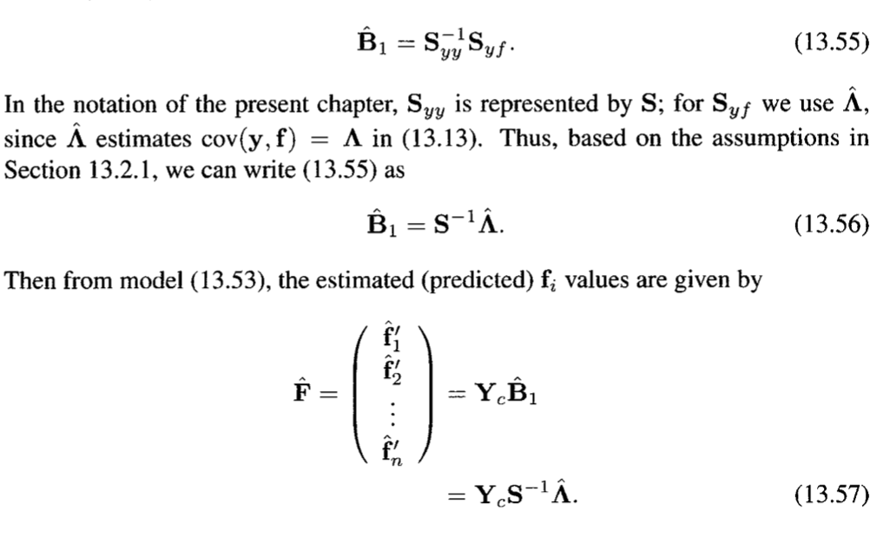

Slide 30
Factor Analysis vs PCA
Goal of factor analysis: find interpretable latent variables
Focus on covariance matrix
Non unique solution
# of factors changes loadings
Goal of PCA: Summarise the variance of data with PCs
Focus on variance
Unique solution
Number of PCs does not change PCs

Slide 31
Midterm Review

